Slide 1
Online Edu. Employment
Prototype 15/9/ 2015

Slide 2
Prototype
Agenda
1. Process of the first sprint
2.Pototype display
3. Conclusion

Slide 3
1.Process of the first sprint
Sprint Planning
.NET and MySql
Estimate time
Sprint Backlog

Slide 4
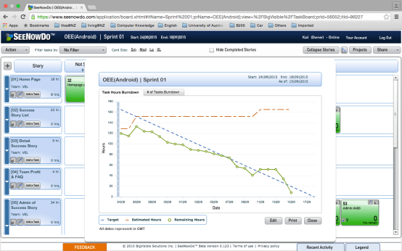
1.Process of the first sprint
Tracking Progress during the Sprint

Slide 5
1.Process of the first sprint
Daily Scrum
Every two days
Help each other
Solve problems

Slide 6
1.Process of the first sprint
Sprint Review
Presented our achievement
Get feedback from product ower

Slide 7
1.Process of the first sprint
Sprint Retrospective
Inspect and adapt regarding the product
Get feedback from every group members

Slide 8
2.Pototype display

Slide 9
3. Conclusion

